Slide 1










CoVotingSys
Council Voting System

Slide 2

Introduction
Project Objectives
Statement of the Problem
Demo
CONTENTS
Alternative Hypothesis
Data Analytics Feature

Slide 3





INTRODUCTION
CoVotingSys is designed to make the voting process for IT Council elections at PHINMA University of Iloilo more transparent, secure, and accessible for students. By using modern technology, the system ensures a fair and trustworthy election experience, addressing the common issues with traditional methods like Google Forms, and creating a more reliable way for students to participate confidently.

Slide 4








Statement of the Problem
The voting system currently used for the College of Information Technology Education (CITE) Council voting elections falls short in key areas like accessibility, security, and fairness, generating real-time results, and real-time number of votes every year levels. This project aims to improve the system, making it more reliable, secure, and user-friendly so that students can participate with confidence in a fair and transparent election.

Slide 5


ALTERNATIVE HYPOTHESIS
There is a significant relationship between the accessibility, security, and fairness of the voting system and the trust of IT students in the election process as well as reduction of possible threats.

Slide 6

ALTERNATIVE HYPOTHESIS
Improving the accessibility, security, and fairness of the voting system significantly increases the voters trust and enhances system security by reducing potential security threats, compared to not addressing these features.

Slide 7






• MODERN VOTING SYSTEM
•USER-FRIENDLY INTERFACE
• ENCOURAGE STUDENTS PARTICIPATION
• SECURITY MEASURES
Project Objective

Slide 8






DEMO

Slide 9

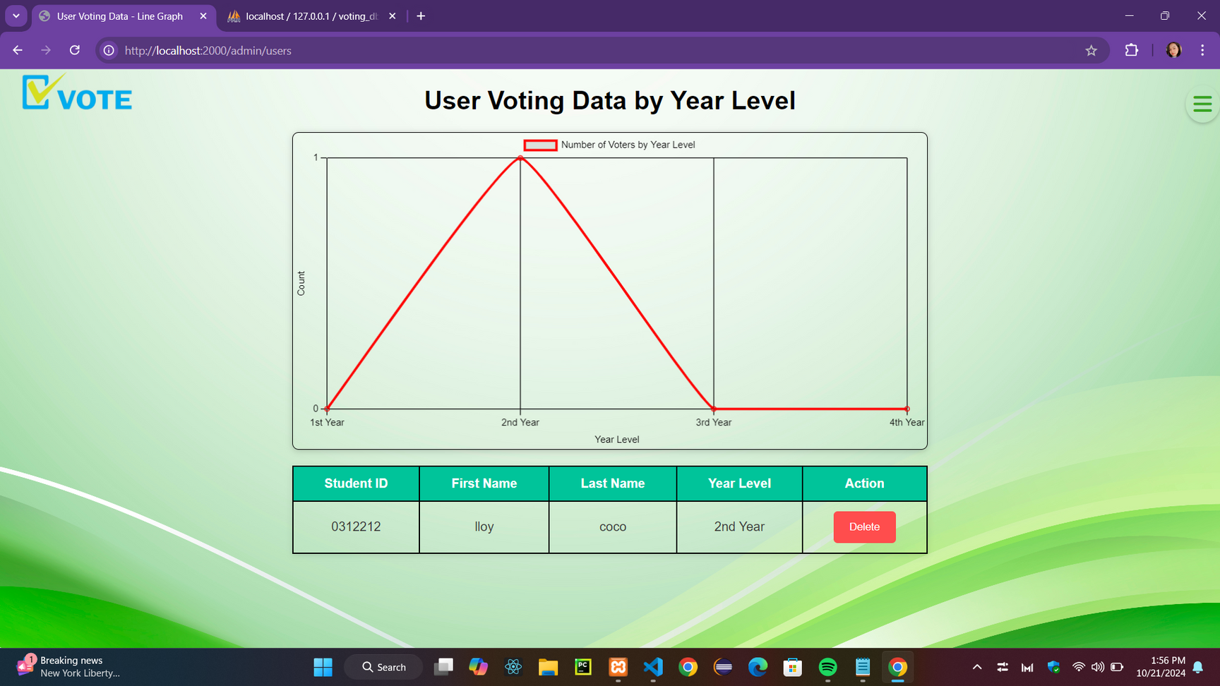
Data Analytics Feature

Slide 10
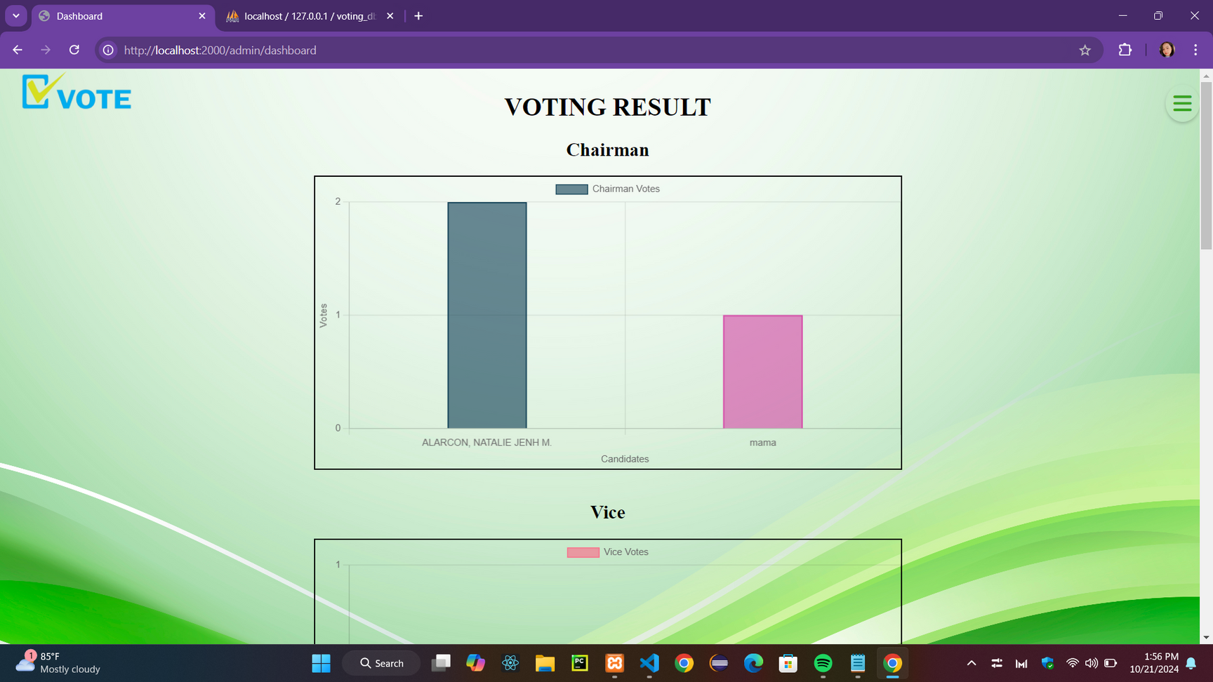
Data Analytics Feature

Slide 11
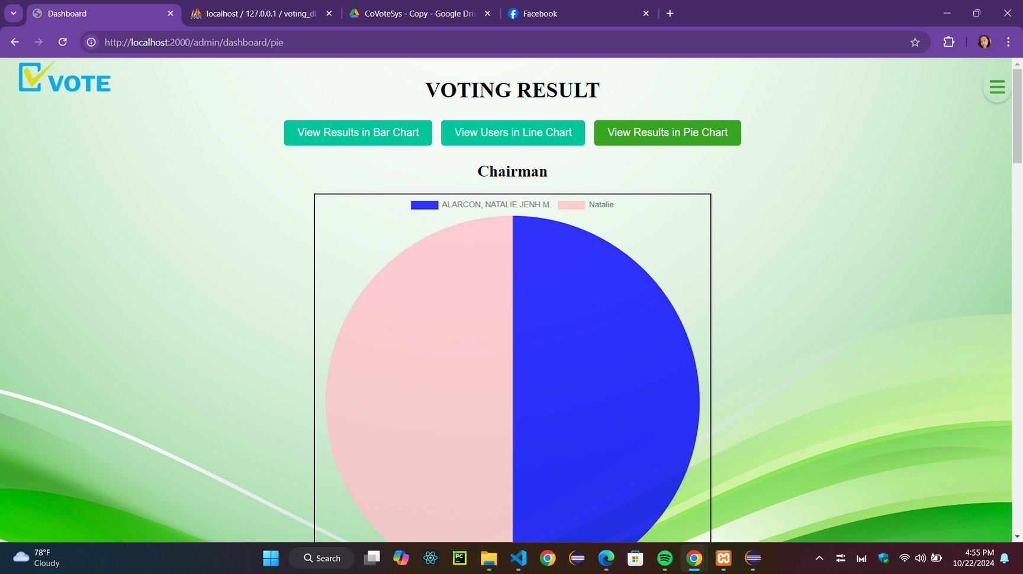
Data Analytics Feature

Slide 12








THANK YOU!

Slide 13





Alarcon, Natalie Jenh
Solilap, Osmhar Lenoux
Dellomes, Marvi Diane
Tangente, Clark Kent
Olarte, Florenz
Benjamin, Edward Allen
Gavile, Ivar John
Jumento, Jhon Dave
Salologan, Kenneth
Almonte, John Lloyd
Bengan, Rhea
MEMBERS

